Slide 1
New Chinese Restaurant in SF Area
Zuhair Bennasser March 17, 2020

Slide 2
Introduction
Opening a restaurant in San Francisco looks like a good investment, the city is busy and a hub for big tech companies. However, this investment is not risk free; NBC BAY AREA reports that in 2019, more than 400 Restaurants closed. Therefore, it is important to do research before opening a new restaurant; Areas of research are for example: type of food, amenities and location.
The type of new restaurant for this project is Chinese, it is a good approach to research the area for existing Chinese restaurants, to avoid opening near them.
In addition, to research the existing restaurants to compare their rating to the amenities they offer, to find out what is the most needed for the new restaurant.
This Approach will help to avoid overpaying for amenities that are not essential for a customer satisfaction, and to focus and pay for the amenities that the customer really need.

Slide 3
Data Source
For Customer Rating: Kaggle Data Set https://www.kaggle.com/jkgatt/restaurant-data-with-100-trip-advisor-reviews-each.
For Restaurants location: Foursquare https://foursquare.com/

Slide 4
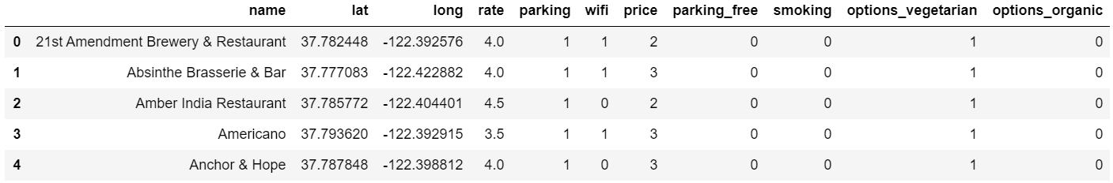
Data From Kaggle

Slide 5
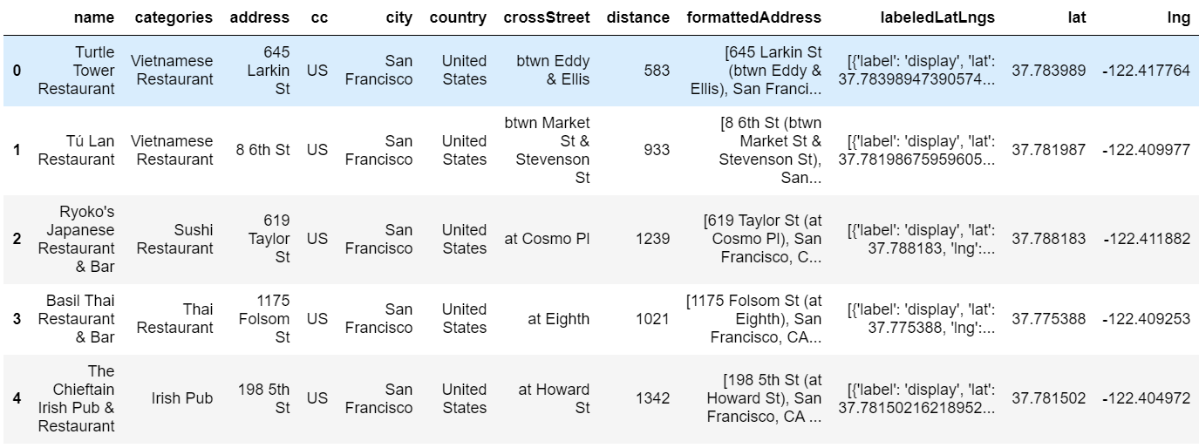
Data from Foursquare

Slide 6
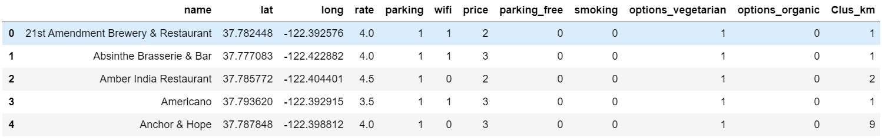
Clustering using K-means(10 Clusters)

Slide 7
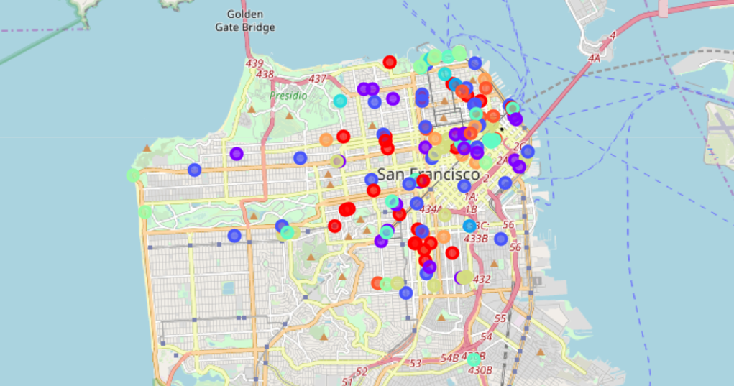
Map the 10 Clusters

Slide 8
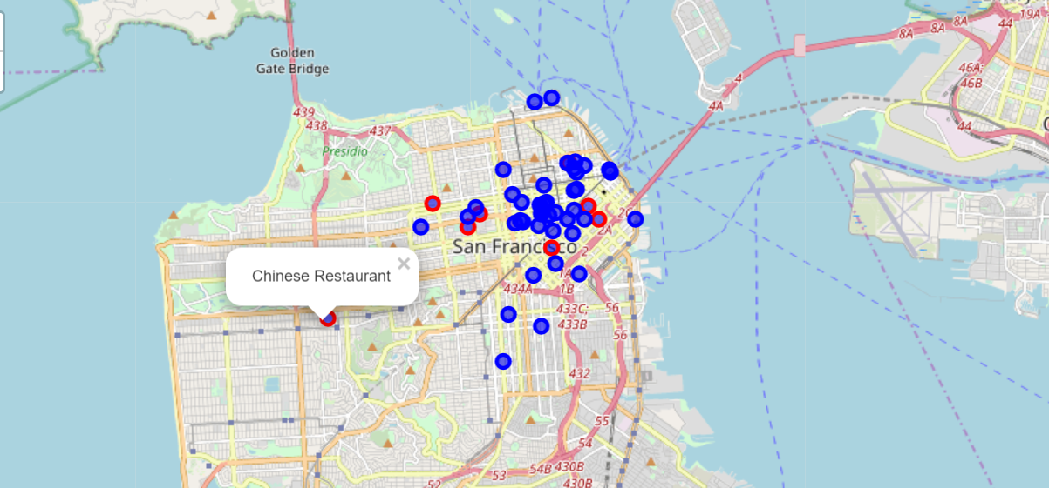
Map the Foursquare Data

Slide 9
Conclusion
The Result of the study is that, opening a new Restaurant that has a good price strategy and has wifi, can increase the chances for good rate. Also by exploring the restaurants types from Foursquare and mapping them, we can find a location where there are no Chinese restaurants.

